Slide 1
Software Engineering Unit II
Prepared by: Neha Tripathi

Slide 2
Requirement Analysis and Specification

Slide 3
Requirement Analysis and Specification phase- An overview
The requirements analysis and specification phase starts after the feasibility study stage is complete and the project has been found to be financially viable and technically feasible.
The requirements analysis and specification phase ends when the requirements specification document has been developed and reviewed.
The requirements specification document is usually called as the Software Requirements Specification (SRS) document.
The goal of the requirements analysis and specification phase is to clearly understand the customer requirements and to systematically organize the requirements into a document called the Software Requirements Specification (SRS) document.
The engineers who gather and analyze customer requirements and then write the requirements specification document are known as System Analyst.

Slide 4
What is Software Requirement?
Requirements are descriptions of the services that a software system must provide and the constraints under which it must operate
Requirements can range from high-level abstract statements of services or system constraints to detailed mathematical functional specifications
IEEE defines requirement as
(1) A condition or capability needed by a user to solve a problem or achieve an objective.
(2) A condition or capability that must be met or possessed by a system or system component to satisfy a contract, standard, specification, or other formally imposed documents.
(3) A documented representation of a condition or capability as in (1) or (2).
Requirements Engineering is the process of establishing the services that the customer requires from the system and the constraints under which it is to be developed and operated. It includes: Requirement Elicitation, Requirement Analysis, Requirement Specification, Requirement Validation and requirement Management.

Slide 5
Types of Requirements
User requirements
Statements in natural language plus diagrams of the services the system provides and its operational constraints.
Written for customers.
System requirements
A structured document setting out detailed descriptions of the system’s functions, services and operational constraints.
Written as a contract between client and contractor
Note: User and system requirements are further divided into Functional and Non-Functional requirements.

Slide 6
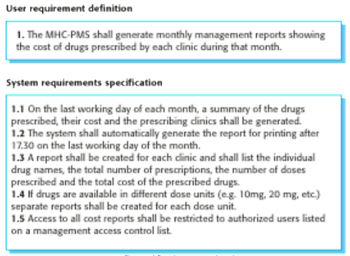
User and system requirements

Slide 7
Functional and Non-Functional Requirements
Functional requirements
Statements of services the system should provide, how the system should react to particular inputs and how the system should behave in particular situations.
May state what the system should not do.
Non-functional requirements
Constraints on the services or functions offered by the system such as timing constraints, constraints on the development process, standards, etc.
Often apply to the system as a whole rather than individual features or services.
Domain requirements
Constraints on the system from the domain of operation
Requirements that come from the application domain of the system that reflect the characteristics of that domain
May be functional or non-functional

Slide 8
Functional requirements
Describe functionality or system services.
Depend on the type of software, expected users and the type of system where the software is used.
Functional user requirements may be high-level statements of what the system should do.
Functional system requirements should describe the system services in detail.

Slide 9
Functional requirements for the MHC-PMS
A user shall be able to search the appointments lists for all clinics.
The system shall generate each day, for each clinic, a list of patients who are expected to attend appointments that day.
Each staff member using the system shall be uniquely identified by his or her 8-digit employee number.

Slide 10
Non-functional requirements
The non-functional requirements (also known as quality requirements) are related to system attributes such as reliability and response time.
Non-functional requirements arise due to user requirements, budget constraints, organizational policies, and so on.
These requirements are not related directly to any particular function provided by the system.
Non-functional requirements should be accomplished in software to make it perform efficiently.
Non-functional requirements may be more critical than functional requirements. If these are not met, the system may be useless.

Slide 11
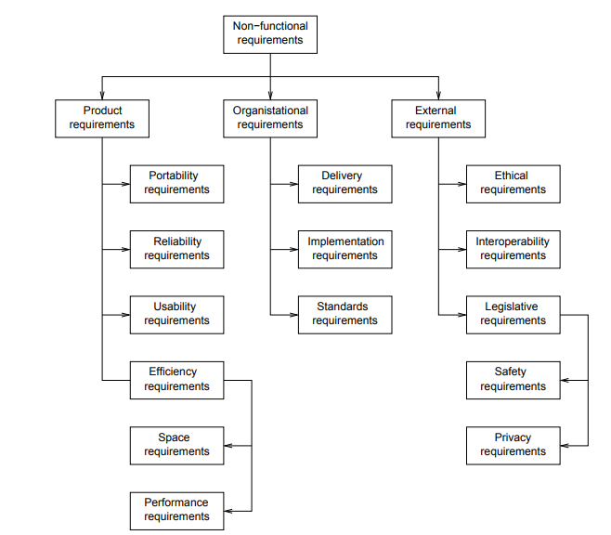
Types of non-functional requirement

Slide 12
Non-functional requirements implementation
Non-functional requirements may affect the overall architecture of a system rather than the individual components.
For example, to ensure that performance requirements are met, you may have to organize the system to minimize communications between components.
A single non-functional requirement, such as a security requirement, may generate a number of related functional requirements that define system services that are required.
It may also generate requirements that restrict existing requirements.

Slide 13
Non-functional classifications
Product requirements
Requirements which specify that the delivered product must behave in a particular way e.g. execution speed, reliability, etc.
Organisational requirements
Requirements which are a consequence of organisational policies and procedures e.g. process standards used, implementation requirements, etc.
External requirements
Requirements which arise from factors which are external to the system and its development process e.g. interoperability requirements, legislative requirements, etc.

Slide 14
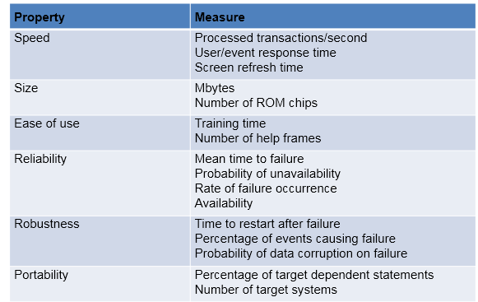
Metrics for specifying non-functional requirements (Non-functional requirements are difficult to verify. Hence, it is essential to write non-functional requirements quantitatively, so that they can be tested. For this, non-functional requirements metrics are used. These metrics are listed in Table.)

Slide 15
Thank you!

